Slide 1
Introduction to Programming With JavaScript
Front-End Web Development

Slide 2
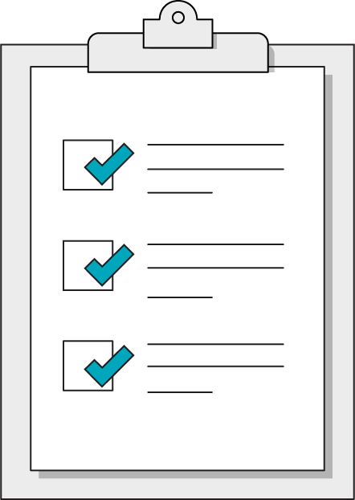
Today’s Learning Objectives
In this lesson, you will:
Distinguish between code and a program.
Define basic variables and data types in JavaScript.
Understand the role of functions in JavaScript.
‹#› | © 2021 General Assembly
Notes:
DURATION: 1 minute
TEACHING TIPS:
Learning objectives help frame the lesson and give students an idea of what to expect and focus on.
Explain to students how this lesson fits into the overall course to help them make connections with content from other lessons.

Slide 3
What Is a Program?
Front-End Web Development
Notes:
TEACHING TIPS:
Get some ideas from students, particularly encouraging anyone thinking more broadly than code. If someone mentions a television program (a planned sequence of scenes) or a program from a live theater performance (a list of the songs and scenes about to happen) that would be excellent.

Slide 4
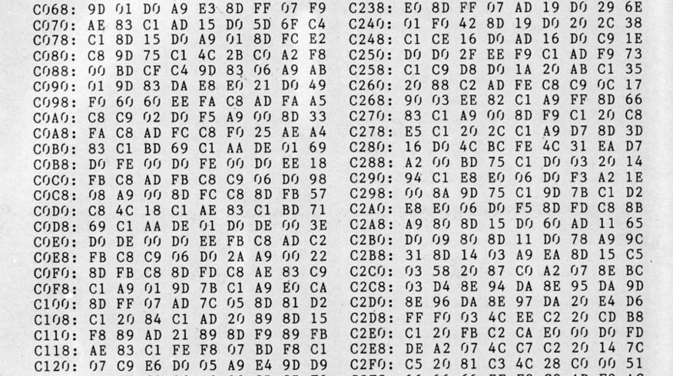
You Might Think a Program Is Code...
Notes:
TEACHING TIPS:
This should line up pretty well with most students’ answers to the question of “What is a program?”

Slide 5
Code is HOW you make a program.
A program is just a set of INSTRUCTIONS.
‹#› | © 2021 General Assembly

Slide 6
The good news about computers is that they do what you tell them to do. The bad news is that they do what you tell them to do.
— Ted Nelson
Notes:
TALKING POINTS:

Slide 7
Thinking Like a Computer
The art of programming requires understanding how a computer thinks:
It only knows what you tell it... | ...but it will remember what it’s been told.
It only understands a very limited set of phrases (syntax)... | ...but you can teach it a lot by combining these basic phrases together.
It will always do what you say... | ...but not necessarily what you meant.
It has no understanding of context... | ...but it’s not shy about saying when it doesn’t understand you (error messages).
Notes:
To learn to write programs for a computer, we’ll have to learn to think like one. https://www.youtube.com/watch?v=cDA3_5982h8

Slide 8
Pseudocode is the process of writing a program without using the syntax of a programming language.
‹#› | © 2021 General Assembly

Slide 9
Variables
Functions
The Nouns of Programming
The Verbs of Programming
Pieces of data in a program that can used and changed many times.
These are used for anything you need the computer to remember or keep track of for later. If you would write it down, it’s a variable.
Modular, reusable containers for an instruction set.
These allow us to define building-block procedures that provide readable instructions for complex operations.
‹#› | © 2021 General Assembly
Notes:
A function: a block of reusable code that can be called anywhere in the program

Slide 10

Thermostat
30 Minutes
Let’s create pseudocode for how a thermostat would work.
‹#› | © 2020 General Assembly
Notes:
TEACHING TIPS:
You can also change this to a partner exercise and have students work in pairs.

Slide 11
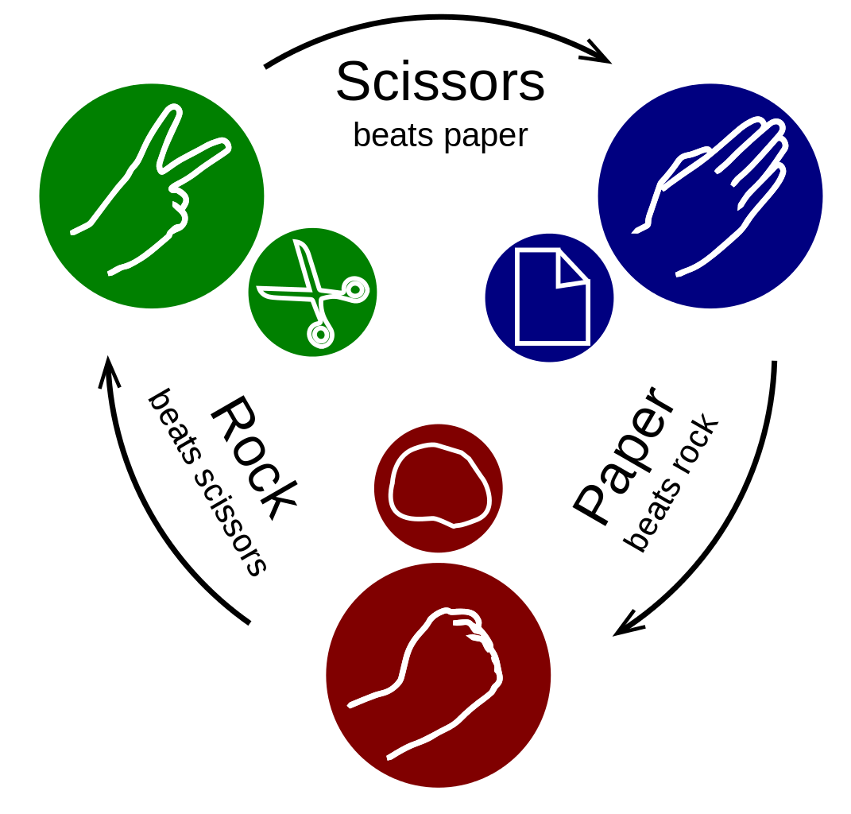
Rock, Paper, Scissors
30 Minutes
Let’s create pseudocode for how the Rock, Paper, Scissors game would work.
‹#› | © 2020 General Assembly
Notes:
TEACHING TIPS:
You can also change this to a partner exercise and have students work in pairs.

Slide 12
JavaScript is the most popular programming language. We’ll write JavaScript code to create programs that run in our browser along with our HTML & CSS.
Notes:
TALKING POINTS:
Using functions is vital to controlling complexity creep.
Without smaller functions to package our reusable pieces of logic, our programs could contain hundreds of the tiniest, seemingly unconnected steps spilled out in a row!
At the lowest level, any instructions would be absurdly difficult to piece together without larger abstracted pieces of logic.

Slide 13
JavaScript: The Basics
Front-End Web Development

Slide 14
JavaScript Reference Desk
You can reference the JavaScript concepts with examples in this CodePen:
Reference code:
https://drive.google.com/drive/folders/15S1w_lYLqORYpxZuSCDpuwcp68A_8KWb?usp=sharing
Notes:
TEACHING TIPS:
Take a while illustrating concepts from this CodePen. Change stuff around, answer questions about how it works, whether things could be done differently, etc.

Slide 15

Basic Data Types
Numbers
Strings
Booleans
Null/undefined
Notes:
TALKING POINTS:
When storing variables, the computer wants to know what kind of information it’s storing. JavaScript will also let us do specific things based on data types and not allow us to do them with the wrong data type. Therefore, it’s important to know the major types of data we can use.
Emphasize just going to highlight these at first, and go over them more in depth in a bit.

Slide 16
Numbers
You've probably seen these before: 0, 1, 2, 3, 4, 5, 6, 7, 8, 9.
They are used mathematically throughout JS code, so normal math rules apply.
They are paired with operators: +, -, *, and /.
10 * 10 ⇒ 100
8 - 4 ⇒ 4
49 / 7 ⇒ 7
They can also include floating point numbers — i.e., decimals or floats.
8.99 + 2 => 10.99

Slide 17
Strings
String means text — that's it!
"It is a beautiful evening";
"Is it really Monday?";
"I am feeling good today!";
With JS, you can merge strings using the "+" operator. This is called “string concatenation.”
"You want " + "to go " + "eat on 14th?";
You can think of a string as a collection of characters tied together.
Notes:
TEACHING TIPS:
Make note that “string concatenation” is now being replaced with “string template literals” and show a corresponding example.

Slide 18
Booleans
Booleans represent the logical concept of true or false.
Other data values can be converted to Booleans for logical analysis.
0, -0, null, NaN, undefined, or the empty string ("") are false.
All other values will be converted to true — if it exists, it’s “truthy.”
Boolean("Jack Nicholson"); ⇒ true
Boolean("1979"); ⇒ true
Boolean(0); ⇒ false

Slide 19
Null/Undefined/NaN
These values denote the lack of value in JavaScript.
null specifically suggests nothing — i.e., certain not to be anything.
undefined suggests a variable will be given a value later but not yet.
NaN means “not a number,” usually because your math has gone wrong.
let lysine;
console.log(lysine);
⇒ undefined
console.log(9 * null);
⇒ 0
console.log("five" * 5);
⇒ NaN

Slide 20
Doing Stuff With Data
Front-End Web Development
Notes:
Start new Intro to JS Codepen

Slide 21
Variables
Variables let us store data in a program.
Declare variables using the let or const, (or var) keywords.
const, short for “constant,” is for variables that won’t be assigned new values.
let is for variables that will be given new values, for example when using math.
var is the legacy way to declare variables.
You refer to variables by using their names anywhere in your program.
let flyingMonkeys = 5;
let tiredGoats = 7
flyingMonkeys + tiredGoats
⇒ 12
Notes:
Go back to CodePen and make some notes on Variables

Slide 22
Variable Naming
Names should be easily understood.
No spaces allowed.
You can use "_", but don’t do it.
Use camelCase: itWorksLikeThis.
let howManyCoasters = 18;
const midWeek = "Wednesday";
Notes:
TALKING POINTS:
camelCase is the standard used for naming variables in JS. Other languages such as Ruby use _.
Make notes in Intro to JS Codepen. Also go over the data types again as variables.

Slide 23
Variable Reassignment
let x = 18;
console.log(x);
⇒ 18
x * 2;
⇒ 18
x = x * 2
console.log(x);
⇒ 36
Note: If you’d used const instead of let to declare the variable, the last part would throw an error!
Notes:
TALKING POINTS:
Just doing * or + won’t actually change the value. Using the assignment operator (= sign) is what overwrites a variable to a new value. You could also write += as a shortcut.
Add to Codepen under Number Variables.

Slide 24
Messages and Alerts
// Writes to webpage
document.write("Yes!");
// Writes to console
console.log("Houston, do you copy?");
// Makes pop ups happen
alert("You destroyed the computer again.");
Notes:
Discuss these, add to CodePen.

Slide 25
Data Types and Logging in JS
30 minutes
Practice using console.log and basic variable operations in JavaScript. There's more than one way of doing practically anything in JS – Google and Stack Overflow will be your best friends in JS land!
Starter code:
https://drive.google.com/drive/folders/1uV18J8cVaDvZHOq6go__dWX3zzK_fS3B?usp=sharing
Solution code:
https://drive.google.com/drive/folders/1B6CQ8HNJzbOFUkwE1YGZnft-Q1oDjhMR?usp=sharing
Notes:
TEACHING TIPS:
You can also change this to a partner exercise and have students work in pairs.

Slide 26
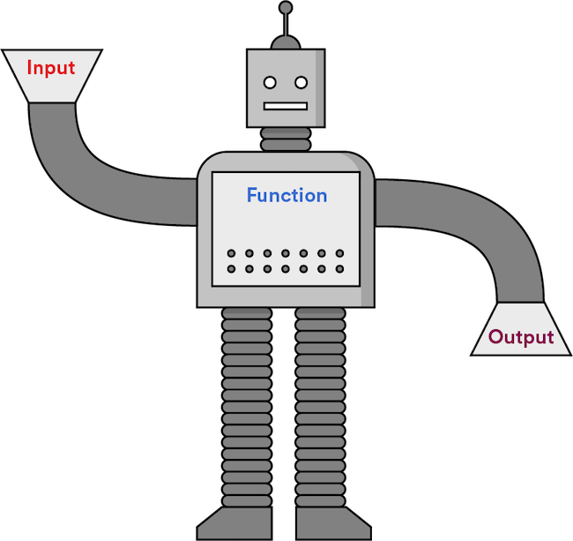
Functions
Functions are chunks of code that are grouped and execute together, like a modular program within a program.
A function takes input, performs logic, and returns output.
Notes:
TALKING POINTS:
We just saw functions on the last slide: console.log and friends take in a message and do something with it!

Slide 27
Functions
Reusable functions need names and follow naming rules that are identical to those of variables.
They must be called or “invoked” to execute and return a value.
They accept input, called parameters, that can be used inside the function.
function greetings(name) {
console.log(“Hello there, “ + name);
}
greetings(“Dave”);
Notes:
TEACHING TIPS:
Spend the rest of class time with basic function challenges, demonstrating the power and problem-solving capability of functions. Functions take some time to get used to, so start early and often with challenges that involve functions!
Go back to Intro to Js codepen, create some functions

Slide 28
Creating Functions in JS
30 minutes
Let’s create a few functions together, and then you’ll create a function of your own!
Starter code:
https://drive.google.com/drive/folders/1E8prrfiB5ZrLxmqPTd_mNR7HavSSm4CN?usp=sharing
Solution code:
https://drive.google.com/drive/folders/1O8my7O-8fAo16aaSWoxeCTWany8NPAKw?usp=sharing
Notes:
TEACHING TIPS:
Depending on your lesson plan, you may want to add more function examples here. You should go through each function separately, allowing students about 5 minutes to try before reviewing the answer to each.
After the Intro to JS examples, I think this will be good for them to do in PARTNERS, not groups, for practice with true pair programming as we move into JS.

Slide 29
Key Takeaways
For Next Time
Computers Think in Small Steps
JavaScript and the DOM
You can define functions to encapsulate common procedures.
Use variables for anything you need the computer to keep track of.
Use JavaScript to interact with elements on the page.
Respond to user actions by setting event listeners.
‹#› | © 2021 General Assembly

